Slide 1
SIG-VMware
Deep-dive into Cluster API vSphere Provider

Slide 2
Introduction
Presenters
Loc Nguyen, VMware
Sidharth Surana, VMware
Definitions
CAPI = Cluster API
CAPV = Cluster API Provider for vSphere
Repo - https://github.com/kubernetes-sigs/cluster-api-provider-vsphere
Agenda
Very brief review of cluster API
Brief history of the Cluster API vSphere provider
Architecture and workflows
Future directions of CAPI and CAPV
Demo
Notes:
40-60 sec

Slide 3
Problem Statements
Deploying Kubernetes clusters and managing them is HARD.
Notes:
10sec

Slide 4
Brief Overview of Cluster API
Manages the lifecycle (CRUD) of k8s clusters
philosophy: “Kubernetes managing Kubernetes”
Provider code are the glue to the cloud infrastructure (e.g. the vSphere or AWS)
Cluster API v1alpha1 - released end of Q1 2019
Built on top of CRDs
Controllers
Cluster
Machine
Machineset
MachineDeployment
It currently supports two operational models
Cluster API manages the cluster it is running on -- self-managing cluster
Cluster API manages children clusters that it creates -- centrally managed clusters
Notes:
2 mins
got stuck on the last bullet item.

Slide 5
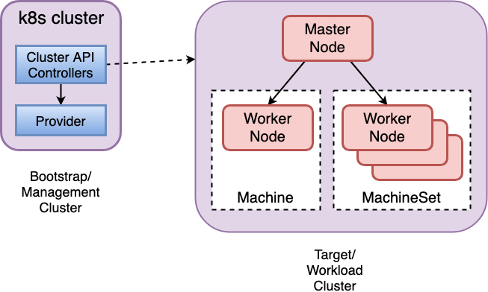
K8s Managing K8s
Notes:
40 sec

Slide 6
History of vSphere Provider
Q3 2018
VMware (pre-Heptio acquisition) joined SIG Cluster Lifecycle and wg-cluster-api
vSphere provider transitioned from Terraform to Govmomi APIs
Q4 2018
vSphere provider transitioned from aggregated API server to CRDs
Added a central repo for official containers
gcr.io/cnx-cluster-api/vsphere-cluster-api-provider
Automated CI and e2e tests
Created an helper OVA
Tagged v0.1
Q1 2019
Features and bug fixes
Compatibility with CAPI v1alpha1
Tagged v0.2
Notes:
2min → 1min
trial run took 2 mins but we can shorten this to 1 min if we don’t do bullet by bullet.

Slide 7
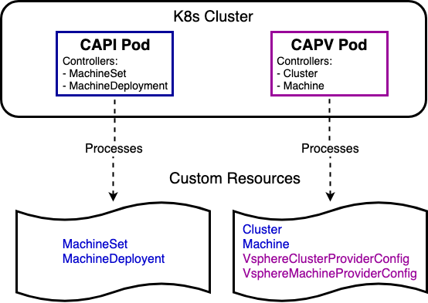
Pods and Types
Note, the cluster and machine controller code are in the CAPI repo, along with code for the machineset and machinedeployment. The CAPV containtainer is the one that “actualizes” the controller. It does so by vendoring the CAPI repo.
Notes:
2min → 1-1.5min ***
There are 3 info conveyed in this diagram. Focus on which controller runs in which pods and the CRD. Shrink to 1-1.5min.

Slide 8
Supported Configurations
Ubuntu Cloud images
Can easily support other distributions
vCenter 6.5+, ESXi 6.5+ for developers
Weave for CNI
In-tree vSphere cloud provider
Will move to out-of-tree in the future
Cloud Init to configure vm
Kubeadm to bootstrap k8s nodes
Helper OVA to facilitate a quickstart
Notes:
1.5min → < 1min
got stuck on the cloud init image section. Focus on vCenter/ESX version and kubeadm for boostrap and just mention the other points (not read it). Can shrink to below 1min

Slide 9
Resource YAMLs
provider-components.yaml
installs cluster api system, types and RBAC roles
cluster.yaml
describes the network and infrastructure credentials
machine.yaml
machine specification for nodes
Notes:
2min → 1min
During the yaml, we can say cluster and machine discussed in next two slides. The provider-components.yaml we must explain.

Slide 10
Cluster Spec
Cluster Spec defined in CAPI repo
Provider Spec defined in CAPV repo
server url
vSphere credentials
apiVersion: "cluster.k8s.io/v1alpha1"
kind: Cluster
metadata:
name: test1
spec:
clusterNetwork:
services:
cidrBlocks: ["10.96.0.0/12"]
pods:
cidrBlocks: ["192.168.0.0/16"]
serviceDomain: "cluster.local"
providerSpec:
value:
apiVersion: "vsphereproviderconfig/v1alpha1"
kind: "VsphereClusterProviderConfig"
vsphereServer: 1.2.3.4
vsphereCredentialSecret: xxx
Notes:
40-60sec → 30sec
I think we can sacrifice this slide. Breeze through this. Don’t dwell.

Slide 11
Machine Spec
Machine Spec defined in CAPI repo
Provider Spec defined in CAPV repo
datacenter
datastore
resource pool
cpu
memory
disks
dhcp or static ip
multiple nics
cert injection
ntp server
vm template
apiVersion: "cluster.k8s.io/v1alpha1"
kind: Machine
...
spec:
providerSpec:
value:
apiVersion: "vsphereproviderconfig/v1alpha1"
kind: "VsphereMachineProviderConfig"
machineSpec:
datacenter: "vicdc"
datastore: "datastore108"
resourcePool: "kube-resource-pool"
networks:
- networkName: "VM Network"
ipConfig:
networkType: dhcp
numCPUs: 2
memoryMB: 2048
template: "xenial-server-cloudimg-amd64"
disks:
- diskLabel: "Hard disk 1"
diskSizeGB: 20
preloaded: false
trustedCerts:
ntpServers:
versions:
kubelet: 1.14.0
controlPlane: 1.14.0
Notes:
1.5-2min → 1min
Can shorten if we don’t go over each and every bullet item. Maybe highlight IP, multiple nics, cert injection. For certificates, don’t explain why it’s useful. Just say we can inject custom certificates onto the host.

Slide 12
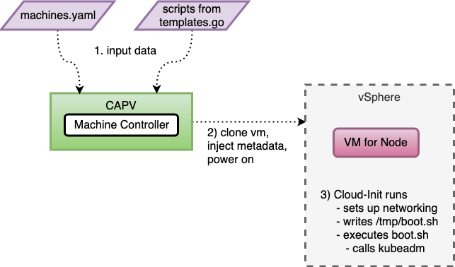
Node bootstrap workflow
Notes:
1min

Slide 13
CAPI Future Directions
CAPI v1alpha2 undergoing redesign
Data model (CRDs)
Extension (how CAPI “talks” to the provider)
Control plane lifecycle
Node lifecycle
Image building
Notes:
2+ min → 1min
stuck explaining data model and extension.

Slide 14
CAPV Future Directions
CAPV 2019
Align with CAPI v1alpha2 redesign
Align feature set with other providers
e.g. High availability (via kubeadm)
Switch to out-of-tree vSphere cloud provider
Enable Zone support
Enable csi-vsphere storage plugin
Support vSphere VM affinity/anti-affinity support
affinity = provision nodes on same ESXi host
anti-affinity = spread provisioning of nodes across ESXi hosts in a vCenter
Externalize node bootstrap scripts from source
Notes:
2+ mins → 1min
Stuck on affinity/anti-affinity and externalize bootstrap scripts. Don’t explain affinity/anti-affinity. Let them read slides and research later. For bootstrap scripts, just say these are used by cloud-init.

Slide 15
DEMO

Slide 16
Workflow with kubectl
Start after cloning repo from github
Edit makefile
modify DEV_IMG to your registry
make dev-yaml
creates a <capv>/out folder
edit <capv>/out/cluster.yaml and <capv>/out/machines.yaml
get access to existing cluster
kubectl create -f provider-components.yaml
kubectl create -f cluster.yaml
kubectl create -f machines.yaml
wait for VM to fully boot
ssh -i ~/.ssh/vsphere_tmp ubuntu@<vm ip>
wait for /etc/kubernetes/admin.conf to get created, then chmod +r the file
exit
scp -i ~/.ssh/vsphere_tmp ubuntu@<vm ip>/etc/kubernetes/admin.conf <local path>/kubeconfig
kubectl --kubeconfig <local path>/kubeconfig get machines

Slide 17
Q&A

Slide 18
Thank You
How to reach us
Slack #cluster-api and #sig-vmware
Bi-weekly community meetings every other Mondays, 1pm PST
Next one 4 June
Github repo
https://github.com/kubernetes-sigs/cluster-api-provider-vsphere

